Slide 1
An Attention Model Based on Spatial Transformers for Scene Recognition

Slide 2
Objective
Addressing scene recognition challenges in computer vision.
They propose an end-to-end pipeline combining Convolutional Neural Networks (CNNs) with an explicit attention model for meaningful region determination in scene recognition.
A Spatial Transformer Network serves as the attention module, autonomously learning scales and movements of attention windows.

Slide 3
1. Using Convolutional Neural Networks (CNNs): Imagine CNNs as smart tools that can understand and interpret different parts of an image. They can identify shapes, objects, and patterns.
2. Adding an Attention Model: Think of an attention model like a spotlight that guides the CNNs to focus on the most important parts of the image. For example, if you're looking at a picture of a beach, the attention model might tell the CNNs to pay extra attention to the sandy shoreline and the waves.
3. Using a Spatial Transformer Network (STN): This is like a magical tool that learns on its own how to zoom in, zoom out, or move around the image to find important details. So, if there's a palm tree in the image, the STN can zoom in on it to see it better.

Slide 4
Introduction
Challenge of Scene Recognition:
Difficulty in representing scenes due to variability, ambiguity, and illumination changes.
Attention Mechanism:
Introducing an end-to-end CNN framework with an explicit attention model inspired by the human visual system.
Spatial Transformer Network Integration:
Detecting meaningful regions in images to generate discriminative descriptors for scenes through feature fusion.

Slide 5
Model
This model is a combination of two networks:
spatial transformer network:
Convolutional Neural Networks:

Slide 6
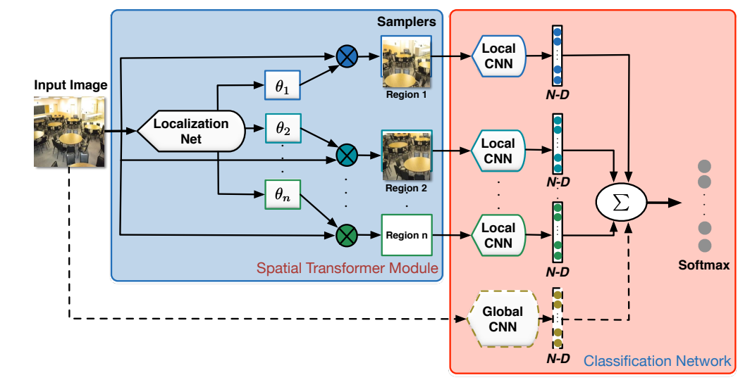

Slide 7
Spatial Transformer Network:
An Overview
The Spatial Transformer Network (STN) is a crucial component in Convolutional Neural Networks (CNNs), introduced for actively transforming feature maps. Key aspects:
Purpose: Enhances the network's focus on relevant parts of the input data.
Composition: Comprises three main parts:
1. Localization Network: Determines spatial transformation parameters.
2. Grid Generator: Creates a grid of coordinates for mapping input to output.
3. Sampler: Transforms the input image based on the grid.

Slide 8
STN in Scene Classification
In this model, the STN is utilized as an attention mechanism for scene classification. This involves:
Function: Learns scales and locations of key image regions (attention windows).
Role in Scene Classification: Enhances the network's ability to focus on and crop out informative regions from images.
Implementation: Uses a constrained 2D affine transformation for automatic cropping.
Significance: Improves accuracy in scene classification by directing focus to critical image areas.

Slide 9
Convolutional Neural Networks
Convolutional Neural Network (CNN) model is central to the proposed method for scene recognition. CNN is combined with a spatial transformer network to form the ST-PlacesCNN.
Introduction:
The Convolutional Neural Network model is pivotal in our approach to scene recognition.
Integrated with a Spatial Transformer Network (STN), forming the ST-PlacesCNN.
Integration with Spatial Transformers:
The STN, preceding the CNN, transforms key image areas, focusing on the most informative regions for enhanced input processing.

Slide 10
CNN Feature Extraction:
Post-STN, the CNN extracts features from these focused areas, significantly improving scene recognition accuracy.
End-to-End Training:
The model is trained end-to-end, learning both scene classification and identification of crucial image parts.

Slide 11
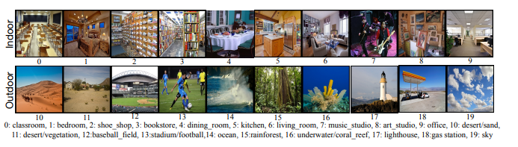
Experiments
Evaluation Dataset:
Places205 dataset
Consist of 205 scene categories
Training dataset – 2,448,873 training images , (5K – 15K images/category)
Validation dataset -100 images/category
Testing dataset – 200 images/category
Evaluation Dataset:
Utilized a subset of 20 classes Places205 dataset – Place20
276,640 training images
2,000 validating images
4,000 testing images
10 indoor scenes and 10 outdoor scenes

Slide 12
Methods for Comparison:
PlacesCNN fine-tuned on Places20 - Baseline trained on Places20
PlacesCNN with different scales of spatial transformer modules - Tests spatial transformer modules with different attention window scales.
ST-placesCNN with different numbers of spatial transformer modules - Explores the impact of varying the number of spatial transformer modules.
ST-placesCNN combining global features with local features - Proposes combining global and local features for enhanced scene descriptors.

Slide 13
Experimental Setup:
Initial fine-tuning of PlacesCNN on Places20 with batch normalization.
Data preprocessing: Resizing to 454×454, downsampling to 227×227, subtracting pixel mean.
CNN outputs a 13×13 spatial resolution with 256 feature channels.
adadelta algorithm for training, dropout of 0.5 after each fully connected layer, weight decay of 10⁻⁵.

Slide 14
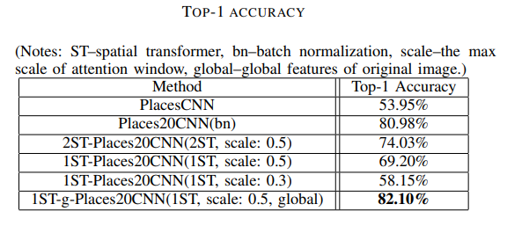
Results and Discussion:
Observations:
Attention Window Scale Impact: Larger scales (0.5) result in better performance (69.20%) compared to smaller scales (0.3, 58.15%).
Number of Spatial Transformers: 2ST-Places20CNN outperforms 1ST-Places20CNN (74.03% vs. 69.20%), emphasizing the benefit of multiple attention windows.
Feature Fusion: Combining global features with local features (1ST-g-Places20CNN) yields the highest accuracy (82.10%).

Slide 15
CONCLUSION
Propose explicit attention model - spatial transformer for scene recognition.
Method:
Combine CNN architecture with spatial transformers.
Detect meaningful and informative regions from original images.
Generate enhanced scene descriptors through feature fusion.
Results:
Outperformed the basic PlacesCNN model.

Slide 16

THANK YOU…!!
Get More Insights Here :

